Slide 1
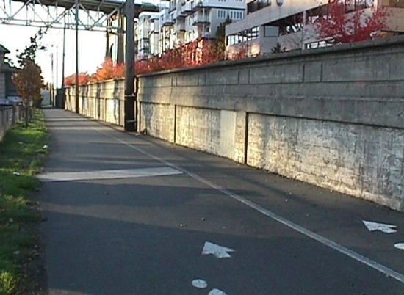
SDOT Asset Management Program Retaining Walls
Geotechnical AM Subcommittee
Jude Willcher, AICP
January 2016

Slide 2
Our mission, vision, and core values
Mission: deliver a high-quality
transportation system for Seattle
Vision: connected people, places, and products
Committed to 5 core values to create a city that is:
Safe
Interconnected
Affordable
Vibrant
Innovative
For all
2
Notes:
Our core values for transportation anchor to the core values that Mayor Murray has laid out in his vision (Move Seattle) for Seattle:
Safe
Interconnected
Affordable
Vibrant
Innovative

Slide 3
Seattle: A Snapshot
One of fastest growing cities in US
Economy is based on high-tech, education, seaport, industry, culture
Geography is hilly, with fresh- and saltwater bodies limiting land area
Geology features glacial till and saturated soils plus earthquake hazard

Slide 4
SDOT Asset Management Background
1970s: started Structures AM program
1980s: started Pavement AM program
2007: Department-wide Program, funded by Bridging the Gap Levy
Program hiatus for 2 years (recession and staffing)
2013: hired new AM Manager to rebuild program
4
Notes:
Long journey to develop full Asset Management Program
2013 going forward:
Educating department and city management as to value (more fact-based decision-making, risk avoidance)
Changing expectations around efficient use of limited public funds (recession, special tax levy proposals), accountability
Reinforcement from new federal transportation performance measures

Slide 5
SDOT Asset Management Background (cont.)
Primary Focus of AM Program Implementation:
Asset Status & Condition Reporting
Central Database for Asset & Work Management
Preliminary Work on AM Practice Areas:
Levels of Service
Risk
Organizational Competency
Performance Measures
5
Notes:
SDOT uses Hansen (Infor) enterprise database system - serves as the central asset data repository and integrates with SDOT’s Geographic Information System (GIS) to allow for spatial reporting and analysis.

Slide 6
SDOT Status & Condition Report
Published December 2015 www.seattle.gov/transportation/inventory.htm
Provides technical information about assets
Useful reference for decision-making
Reference guide for general public
Informs future year budgets
Gap analysis to increase AM competency
Notes:
The Status and Condition Report is our primary tool to communicate with elected officials and public:
Resource guide on all our assets, Staff can use the Executive Summary and Table II – Transportation Inventory sheet as a quick reference guide.
Serves as a useful reference for department staff when making decisions and for better managing scarce resources.
Attempts to take the mystery out of what we have and what we do – builds transparency on what we know and why it is important.
Informs future year budgets and transportation capital project development.
Helps to identify gaps/steps SDOT will need to take to increase its competency in Asset Management. For example, where are we missing data and is it important to capture this data for decision making. What assets are poor and does that matter? Should we run to failure or perform preventative maintenance.

Slide 7
Expanded Report
Long-term operational cost forecasting
Measures and trends that link to performance.seattle.gov/
Estimated asset data confidence, replaced asset condition TBD with Unknown
Better unit cost data, e.g., sidewalks by sq. ft., component
Revised asset classes to better align with AM practices
Bookmarked PDF, easily navigable with icons for each chapter in the footer
Notes:
The Status and Condition Report has evolved over the last several years. The current report includes:
value and condition
performance measures
data quality
funding needed to maintain and sustainably preserve them
input on new assets needs along with transportation network capacity
Tools – interactive web links, improved navigation in PDF by using bookmarks

Slide 8
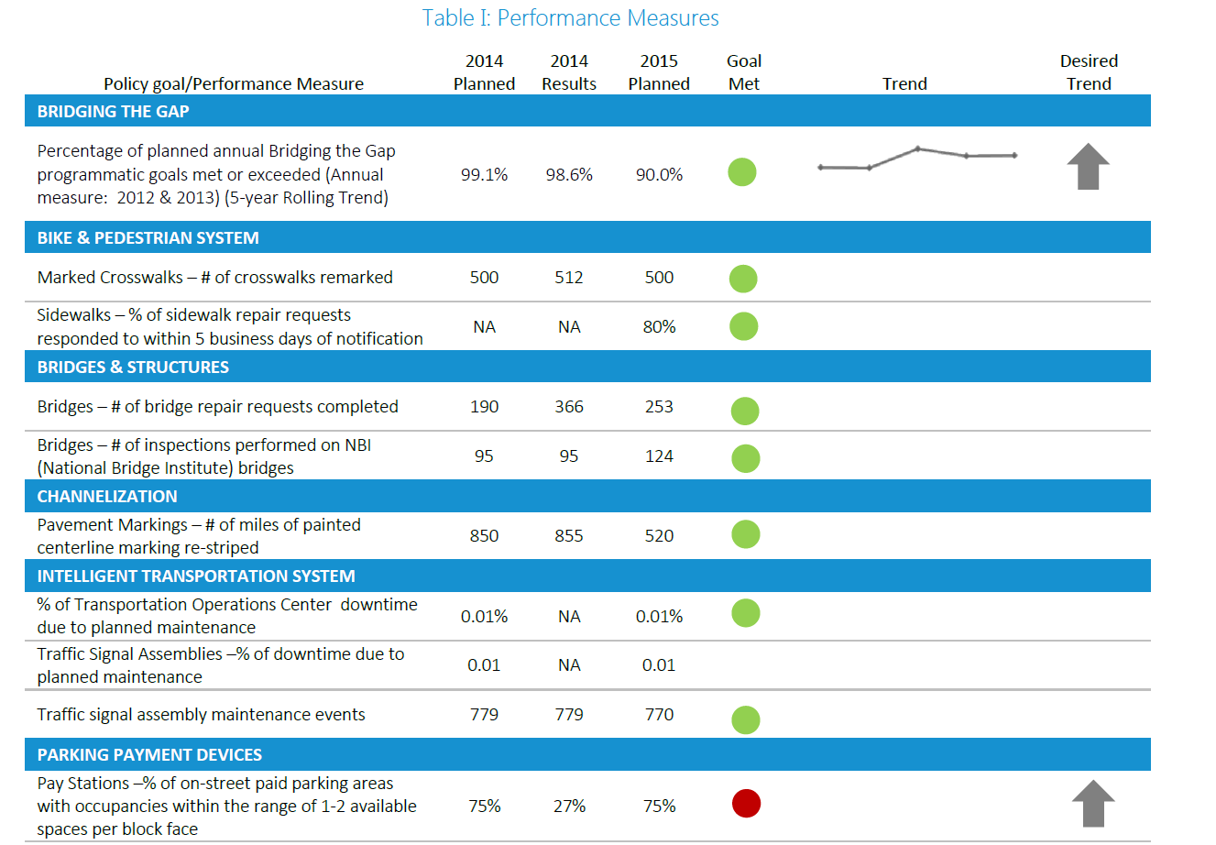
Notes:
Table I does not include all performance measures, just a few highlights from each asset class.
Table I is an example of how we:
Graphics help tell the story to multiple audiences – e.g. infographic on how ITS connects the network.
Tried to replace narrative with graphic when it made sense.
It is a challenge to present technical information to inform the variety of audiences.
Used different graphics, figures to explain at various levels: Telling the Asset Stories…

Slide 10
Notes:
By doing a 50-year forecast, we can inform decision-makers not only about upcoming costs but can also model consequences of deferring investments (“so what”.

Slide 11
Notes:
This is forecast just for bridges and structures.
Seattle has a couple of structure classes that are a little unusual: seawalls and areaways. I’ll give a quick overview of the seawall in a few minutes.
Areaways are usable areas under the street and between buildings. Most of the 115 areaways in downtown were created when City engineers raised Pioneer Square’s streets a full story following the Great Seattle Fire of 1889.

Slide 12
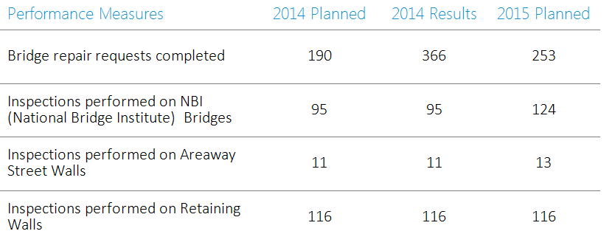
Notes:
Inventory Status and Anticipated Annual Growth
Roadway Structures database has maintained the inventory of retaining walls since 1994. In 2013, we converted the inventory to the Hansen Asset Management central data repository.
On average, 5-10 new retaining walls are built each year, or approximately 1,125-3,375 square feet.
Developers often build retaining walls, and turn over ownership and maintenance responsibility to SDOT after construction. Pressure to develop otherwise marginal properties is increasing with rapid population and economic growth.
The number of new retaining walls built per year may increase dramatically if there is a high incidence of landslides in any given year, as was the case in 1996-1997 when ten (10) new retaining walls were built.
The estimated replacement value of retaining walls includes the Alaskan Way Seawall.

Slide 13
Retaining Wall Inventory Status
Notes:
We assess retaining wall condition through periodic inspection. Complete inspection of retaining walls started in the late 1980s and has been conducted on an average of once every ten (10) years given current funding levels. Roadway Structures engineers would prefer to conduct condition assessments every five (5) years but funding limitations do not allow this.
SDOT conducts regular inspections, including underwater inspections, and monitoring of the Alaskan Way Seawall.
We repair retaining walls on a priority basis up to the level of available funding according to the same maintenance response criteria.
This funding allows Roadway Structures to inspect and maintain the retaining walls in a functional state, but does not allow establishment of a maintenance program that will ensure repair of defects that would prevent further deterioration of the retaining wall, nor to rehabilitate or replace aging retaining walls. Rehabilitation and/or replacement of retaining walls is conducted on a case-by-case basis as part of a capital project.

Slide 14
Retaining Wall Inspections
Tend to sag or move rather than catastrophic failure
Need to understand the failure mechanisms
Difficult to predict useful life
Inspection is critical to determining remaining life along with the consequence and risk of loss
Use condition and criteria to determine rate of inspection (emergency access, impact of failure on system, designated priority transit, freight, pedestrian, and bicycle routes)
Notes:
Retaining walls are difficult to predict useful life. Much easier to understand the failure mechanisms for gravity structures – mass keeps them in place. Bridges also much easier because they’re easier to access.
For retaining walls, condition through inspection is more critical. Data points – condition not deteriorating, can be fairly confident the useful life can be extended. When you see the deterioration curve can then predict remaining useful life.
Would like to see a more robust inspection program. Long term operational cost – less realistic with good condition retaining walls. Consequence of risk – how important is that structure?
Ideal inspection program – adjust frequency based on condition, consequence of failure, structure type some deteriorate faster), ideal range is 3 – 5 years depending on criteria.

Slide 15
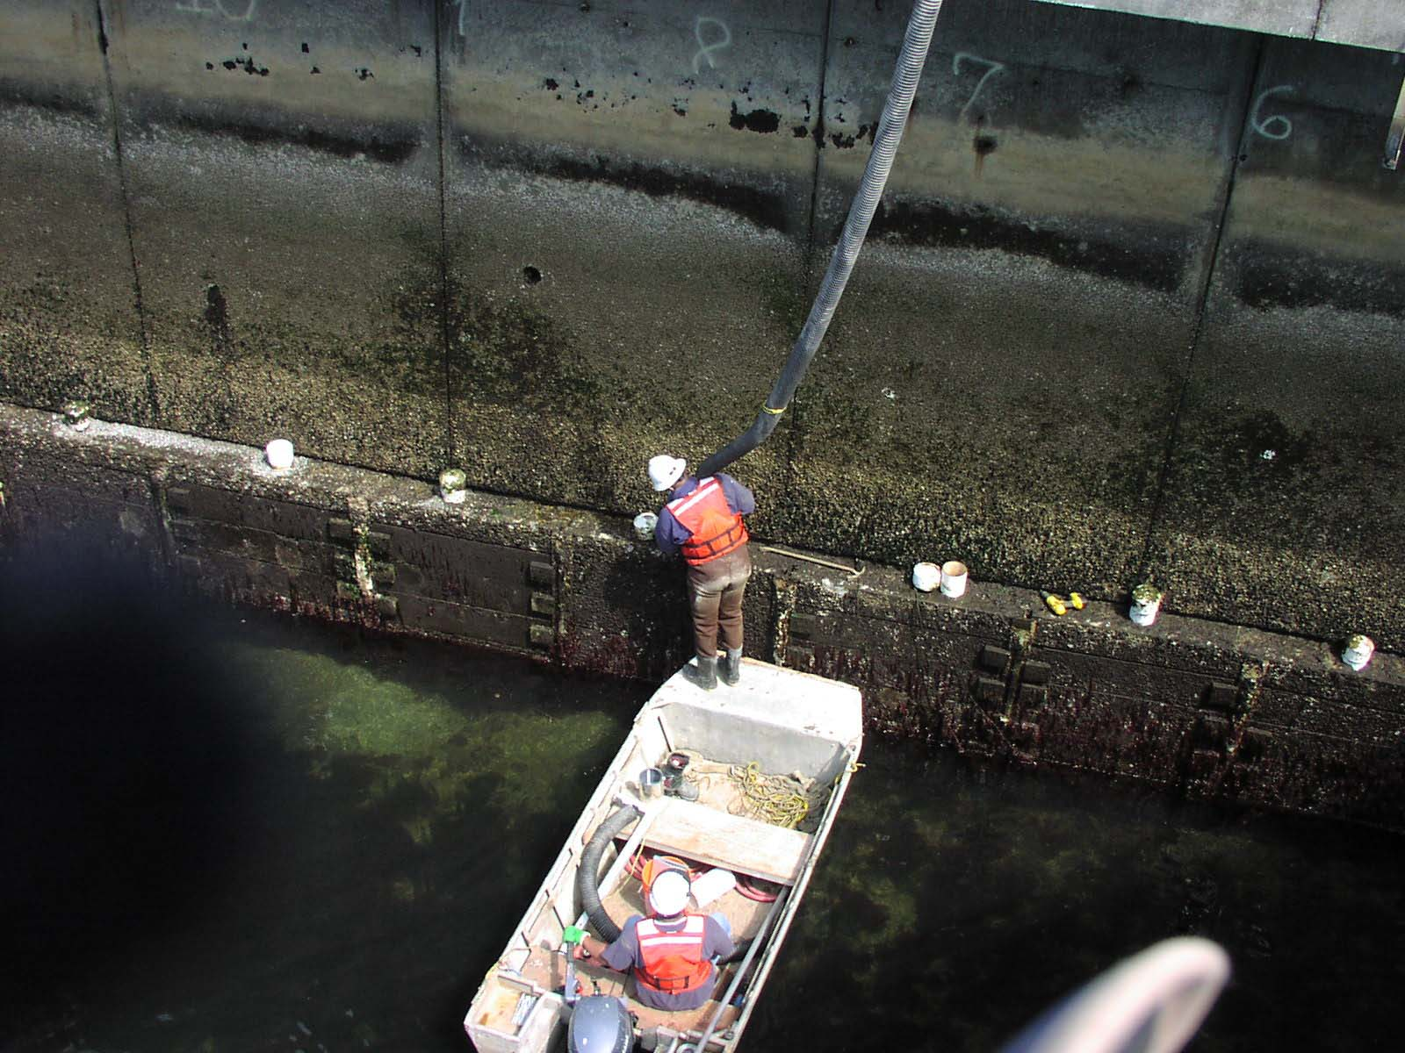
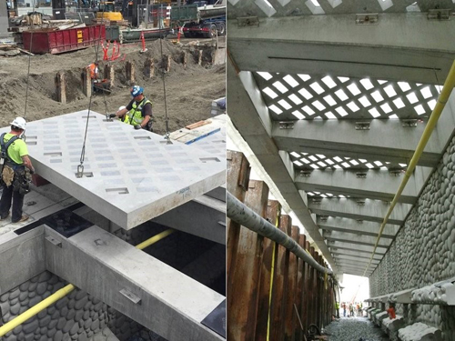
Alaskan Way Seawall
Seattle’s longest retaining wall, at 7,000 feet
Protects the central city waterfront along Elliott Bay
http://www.waterfrontseattle.org
Notes:
The Alaskan Way Seawall is the city’s longest retaining wall, measuring over 7,000 feet in length, and protects the central city waterfront along Elliott Bay.
Left picture is an inspection of the old structure
Right picture is the new wall and sidewalk structure w/ cantilevered/windowed sidewalk
The northern portion of the central seawall is more than 70 years old and considered to be in poor condition. SDOT is in the process of a multi-year replacement of the southern 4,000 feet of the central waterfront section of the seawall.
In recent years, SDOT has performed some major repair work via capital projects on portions of the seawall, including earthquake damage repair following the 2001 Nisqually Earthquake.
Seawall – design criteria used long term asset management. We ask how can you minimize the cost over the life cycle by building into the design ways that support its longevity. Design life is 75, but want it to last 100 years, including accommodations for sea level rise.
Material – higher cost to extend the life. Chose design detailing (eliminated some design solutions because we couldn't’ verify their long term performance.) Cantilever sidewalk was a challenge because of how you resist the gravity – putting an anchor down to the ground was not accepted in the saltwater environment. Made it function w/ gravity with weight and concrete to avoid collapse.
Key desired outcome is to promote habitat, especially for endangered salmon. Materials and textures were researched and used to provide light, safe refuge and aquatic food sources.
Used a General Contractor Construction Manager (GCCM) alternative public works contract to put more value in constructability. GCCM informs us on what would make it easier, but didn’t work as anticipated. Couldn’t pump all that water. Also needed to work with the tide situation. Needed a cut off wall on land and water. Contractor used sheet metal on sea side, freezing on ground side.
Team is reviewing costs, validation of assumptions, management assumptions are based on the level of service. Were our assumptions correct.
Project anticipated to be complete by 3rd q 2017.

Slide 16
Questions?
terry.martin@seattle.gov | (206) 615-1744
emily.burns@seattle.gov | (206) 733-9972
john.buswell@seattle.gov | (206) 684-5301
http://www.seattle.gov/transportation/assetmanagement.htm
www.seattle.gov/transportation

