Slide 1
Unstable Slope Management Program (USMP) for Federal Land Management Agencies (FLMA’s)
Eli Cuelho, PE Darren Beckstrand, CPG Dave Stanley, CPG Paul Thompson Douglas A. Anderson, LEG | MSU – Western Transportation Institute Landslide Technology DA Stanley Consulting Consultant FHWA – WFLHD

Slide 2











Project Partners
Managing Agency
Principal Investigators
Participating Agencies

Slide 3
Background
Phase 1: FHWA project contracted to AKDOT
  Included adaptation of AKDOT’s USMP for FLMAs with stakeholder input, test ratings, and criteria definitions.
Phase 2: FHWA project subcontracted to WTI
  Consists of 15 tasks
  Scheduled for completion September 2017

Slide 4
Phase 1 - USMP for FLMA Combined Form

Slide 5
Phase 1 - Rated Sites

Slide 6
Phase 2
Task 1 – Performance Measures (LT/DASC)
Tasks 2 & 3 – Initial Database Development (WTI)
Task 4 – Input Phase I Data (WTI/LT)
Task 5 – Site Visits & Conceptual Costs (LT)
Task 6 – Cost-Benefit Alternatives (PDT/LT/DASC)
Tasks 7, 10, 13 – Database, GIS Integration, Searching, Mobile App Development (WTI)
Tasks 8, 9 – Field Manual & Training Tools (LT/WTI)
Tasks 11, 12 – New Forms (Maint. Tracking/New Slope)
Task 14 – Qualitative Risk Analysis Module (NPS)
Task 15 – Tech Deployment & Training Course

Slide 7
Phase 2
Task 1 – Performance Measures (LT/DASC)
Tasks 2 & 3 – Initial Database Development (WTI)
Task 4 – Input Phase I Data (WTI/LT)
Task 5 – Site Visits & Conceptual Costs (LT)
Task 6 – Cost-Benefit Alternatives (PDT/LT/DASC)
Tasks 7, 10, 13 – Database, GIS Integration, Searching, Mobile App Development (WTI)
Tasks 8, 9 – Field Manual & Training Tools (LT/WTI)
Tasks 11, 12 – New Forms (Maint. Tracking/New Slope)
Task 14 – Qualitative Risk Analysis Module (NPS)
Task 15 – Tech Deployment & Training Course (LT/WTI)

Slide 8
Performance Measures – USFS
DOTs have Functional Classification, the USFS have 5 Maintenance Levels
  ML-1 are in ‘Storage’
  ML-2 ‘High Clearance Vehicles’
  ML-3 Open & Maintained, comfort/convenience not a priority
  ML-4 Moderate comfort at moderate speeds
  ML-5 High comfort, paved (usually), highest FS standard

Slide 9
Performance Measures – USFS
Condition Performance Measurement
Management Performance Measurement

Slide 10
Performance Measures – USFS
Condition Performance Measurement
  Needed to develop management and assessment approach for each ML
 | Mgmt | Assessment | Planned Assessment
ML-1 | Reactionary | Judgment | None, Maint. tracked
ML-2 | Reactionary | Judgment | None, Maint. tracked
ML-3 | Proactive | % G/F/P – 5yr cycle, low goals | Preliminary GAM
ML-4 | Proactive | % G/F/P – 5yr cycle, mod. goals | Detailed GAM
ML-5 | Proactive | % G/F/P – 5yr cycle, high goals | Detailed GAM

Slide 11
Performance Measures – USFS
Condition Performance Measurement
  Minimum Cond. Lvl. for Route Segments
 | GOOD | FAIR | POOR
ML-1 | Few to no US* | Few/Occ. US (1-2/mi) | Many US
ML-2 | Few to no US, Log haul not impacted | Few/Occ. US | Many US
ML-3 | 80% Good, 10% Poor | 70% Good, 15% Poor | 40% Fair or Poor
ML-4 | 85% Good, 5% Poor | 80% Good, 10% Poor | 30% Fair or Poor
ML-5 | 95% Good, 2% Poor | 90% Good, 4% Poor | 20% Fair or Poor
* Unstable Slopes

Slide 12
Performance Measures – USFS
Condition Performance Measurement
  Route Closures due to Geotech Failures
 | GOOD | FAIR | POOR
ML-1 | Not Blocked – No Threats | Minor Rehab to open to ML 2 | Major Rehab to open to ML 2
ML-2 | Not Blocked – No Threats | Commonly blocked @ rate of 1 / 5 miles | Commonly blocked @ rate of 1 / 2 miles
ML-3 | 1 closure / 10 mi / 3 yrs | 1 closure / 5 mi / 3 yrs | 1 closure / 5 mi / 1 yr
ML-4 | 1 closure / 15 mi / 3 yrs | 1 closure / 10 mi / 3 yrs | 1 closure / 5 mi / 3 yr
ML-5 | 1 closure / 20 mi / 5 yrs | 1 closure / 10 mi / 5 yrs | 1 closure / 10 mi / 3 yr

Slide 13
Management Perf. Measures
Goal – Maintain slope condition to applicable Good-Fair-Poor service levels.
 | Previous Period | Current Period | Perf. Target | Trend
ML-1 |  |  | None
ML-2 |  |  | Fair
ML-3 |  |  | <1 per 3 years per 10 miles
ML-4 |  |  | <1 per 3 years per 15 miles
ML-5 |  |  | <1 per 5 years per 20 miles

Slide 14
Management Perf. Measures
Goal – Ensure Safety, Mobility, & Reliability
  Limit Closure Times & Track Trends
    6 Mos (ML-1) to 1 day (ML-1)
    Track average times per monitoring period to demonstrate performance

Slide 15
Management Perf. Measures
Goal – Focus on High Priority Roads for Improvement.
 | Previous Period | Current Period | Perf. Target | Trend
ML-1 |  |  | None
ML-2 |  |  | Fair
ML-3 |  |  | Avg. Score (prelim) <21 Good
ML-4 |  |  | Avg. Score <200, Good
ML-5 |  |  | Avg. Score <175, Good

Slide 16
Phase 2
Task 1 – Performance Measures (LT/DASC)
Tasks 2 & 3 – Initial Database Development (WTI)
Task 4 – Input Phase I Data (WTI/LT)
Task 5 – Site Visits & Conceptual Costs (LT)
Task 6 – Cost-Benefit Alternatives (PDT/LT/DASC)
Tasks 7, 10, 13 – Database, GIS Integration, Searching, Mobile App Development (WTI)
Tasks 8, 9 – Field Manual & Training Tools (LT/WTI)
Tasks 11, 12 – New Forms (Maint. Tracking/New Slope)
Task 14 – Qualitative Risk Analysis Module (NPS)
Task 15 – Tech Deployment & Training Course (LT/WTI)

Slide 17
Cost – Benefit Approach
Most geotech inventories have followed simple approach
  RHRS: Mitigation cost/score ratio (bang for the buck) and worst first
  WSDOT: Mitigation cost w/OH to risk cost (maintenance, life-safety)
TAM approach
  Use M&O, user, and improvement costs to prolong deterioration and justify expenditures

Slide 18
TAM Approach
Consistent with agency mission & objectives
Objective and consistent through inventory, time, inspectors
Based on reliable data, where possible
Sound engineering and economic reasoning
Tolerant of missing or estimated data
Able to be improved over time

Slide 19
Four Approaches Formulated
Computed benefits and costs (requires the most data)
Priority index (simpler, more generalized)
USMP score priority index (light data requirements, worst first, doesn’t consider life cycle or user costs)
Hybrid of 1 and 2 (reliable with incomplete database, sound engineering and economic analysis)

Slide 20
Approach 1 - Example
Project | AADT | Detour Length | Likelihood | Life Cycle | Cost Risk | Benefit | Mit. Cost | BC Ratio
13.26 | 500 | 30 | 0.3 | 8565 | $531k | $168k | $645k | 0.26
21.71 | 100 | 30 | 0.3 | 6231 | $126k | $ 44k | $112k | 0.39
25.11 | 100 | 30 | 1.0 | 8906 | $114k | $124k | $332k | 0.37
24.63 | 100 | 30 | 1.0 | 27074 | $148k | $175k | $545k | 0.32
28.36 | 100 | 30 | 1.0 | 6597 | $111k | $117k | $811k | 0.14

Slide 21
Phase 2
Task 1 – Performance Measures (LT/DASC)
Tasks 2 & 3 – Initial Database Development (WTI)
Task 4 – Input Phase I Data (WTI/LT)
Task 5 – Site Visits & Conceptual Costs (LT)
Task 6 – Cost-Benefit Alternatives (PDT/LT/DASC)
Tasks 7, 10, 13 – Database, GIS Integration, Searching, Mobile App Development (WTI)
Tasks 8, 9 – Field Manual & Training Tools (LT/WTI)
Tasks 11, 12 – New Forms (Maint. Tracking/New Slope)
Task 14 – Qualitative Risk Analysis Module (NPS)
Task 15 – Tech Deployment & Training Course (LT/WTI)

Slide 22
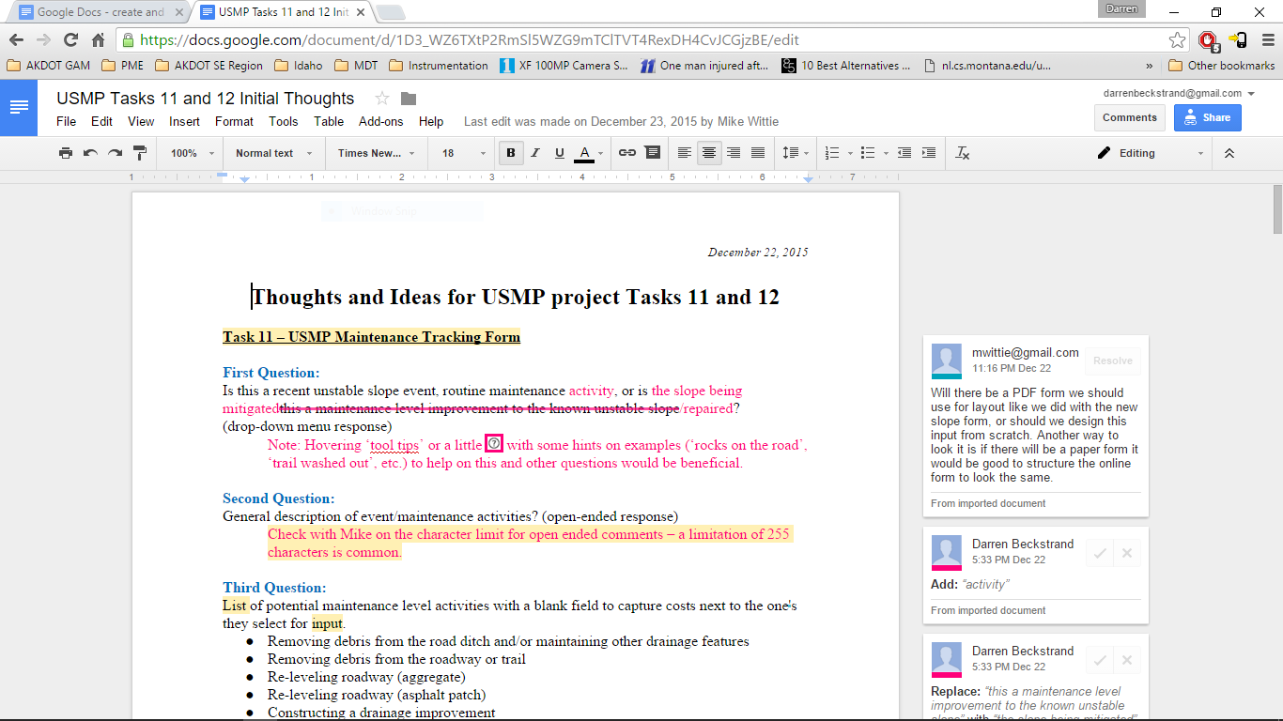
Maintenance Tracking Form
Notes:
Minimal Questions focused location, maintenance activity, and costs.

Slide 23
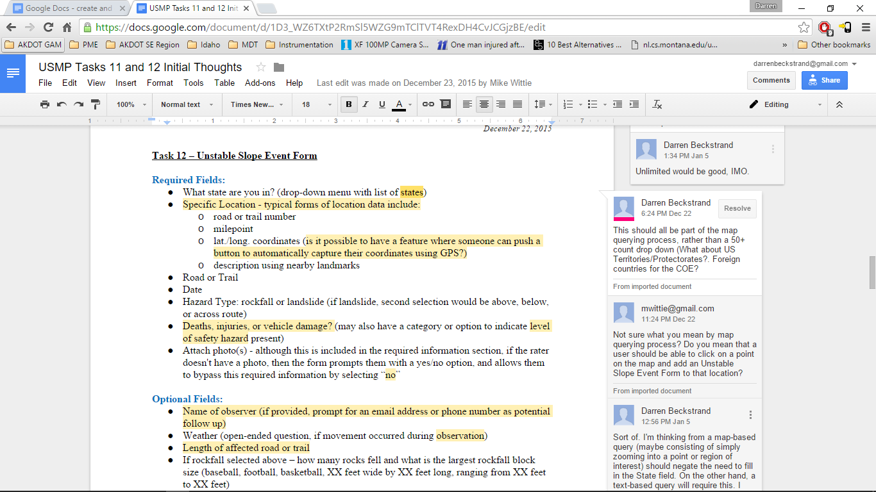
Event Tracking Form
Notes:
Minimal Questions focused location, maintenance activity, and costs.

Slide 24
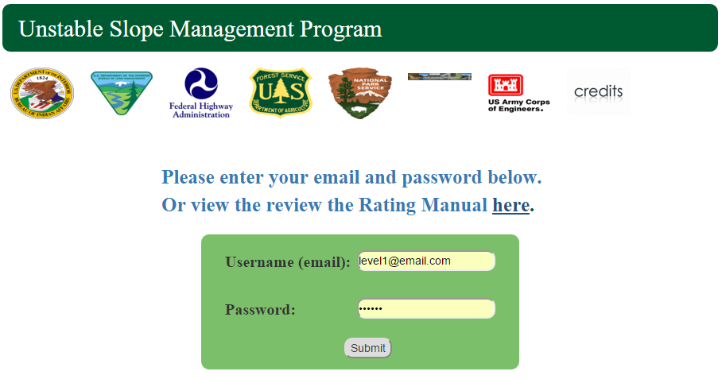
WTI’s Website

Slide 25
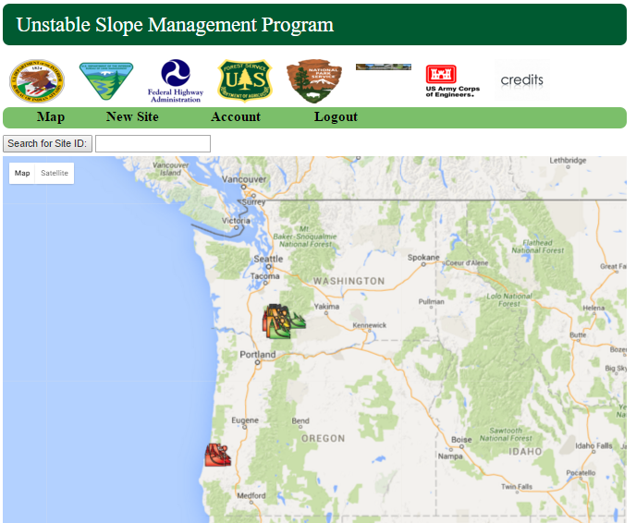

Slide 26
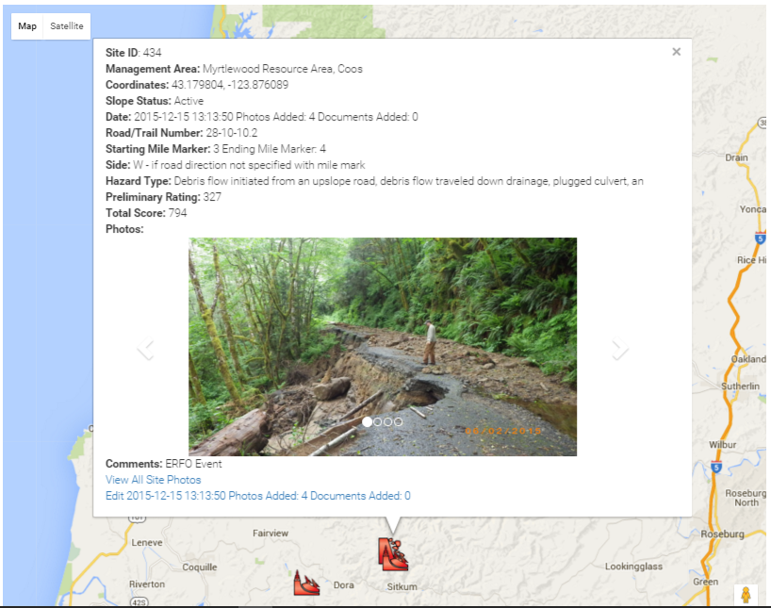

Slide 27
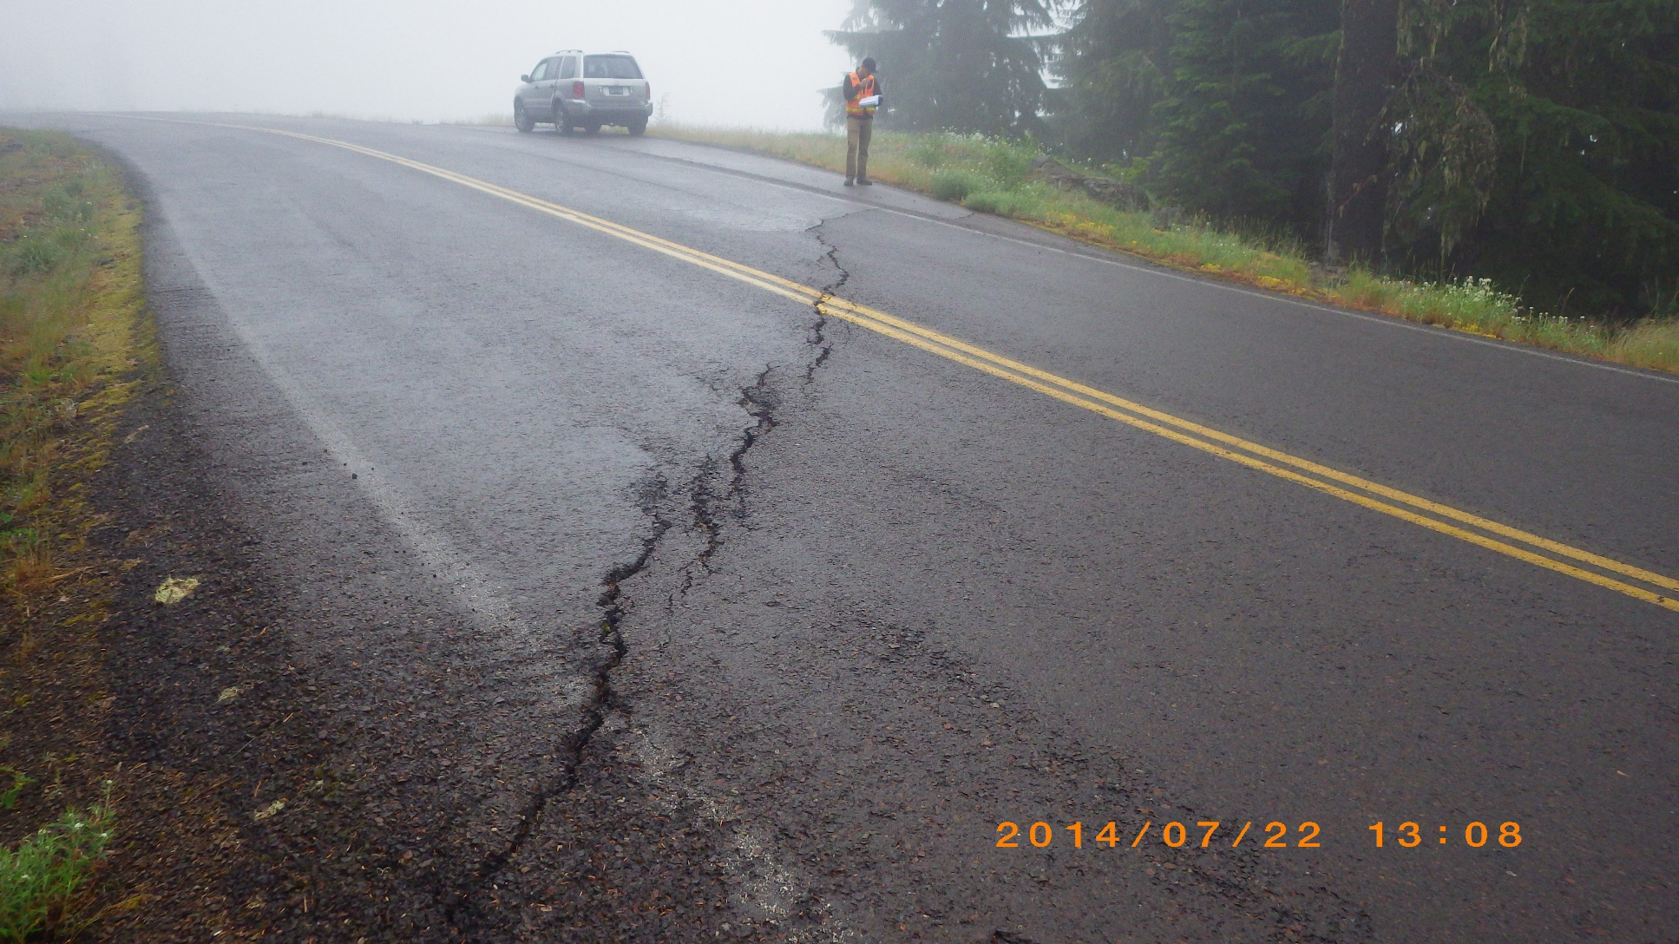
Questions?

Slide 28
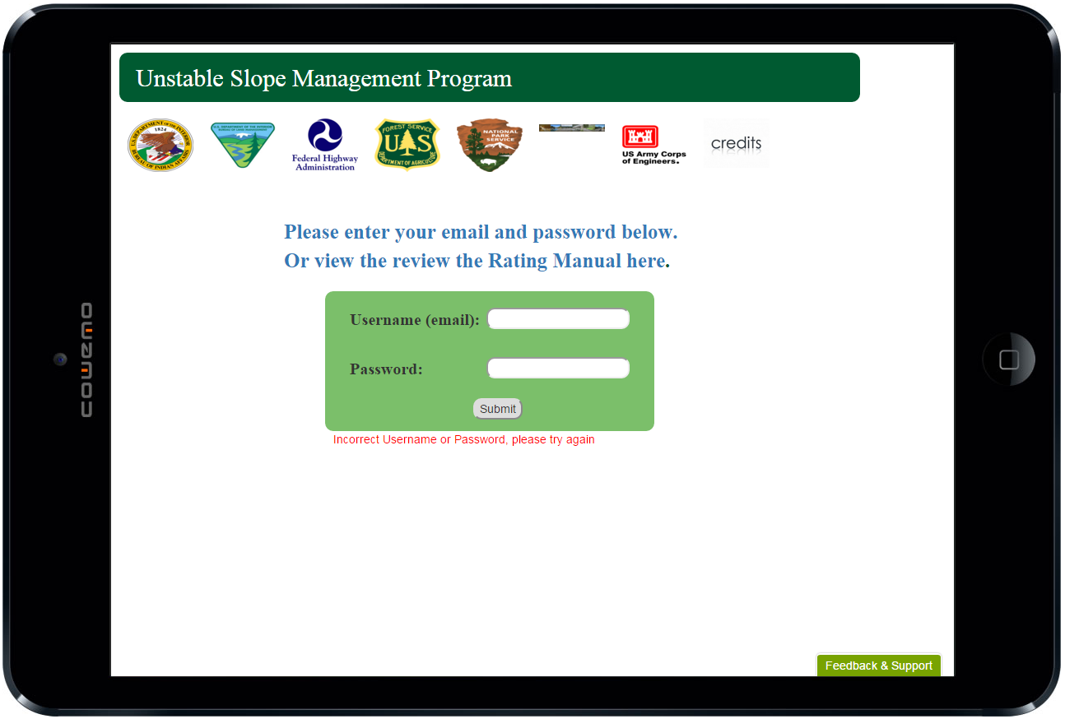
WTI’s Mobile App

