Slide 1
Geotechnical Asset Management Colorado DOT Update
TRB Geotechnical Asset Management Subcommittee
January 2016
Mark Vessely, P.E., Shannon and Wilson, Inc.
Ty Ortiz, P.E., Colorado Department of Transportation

Slide 2
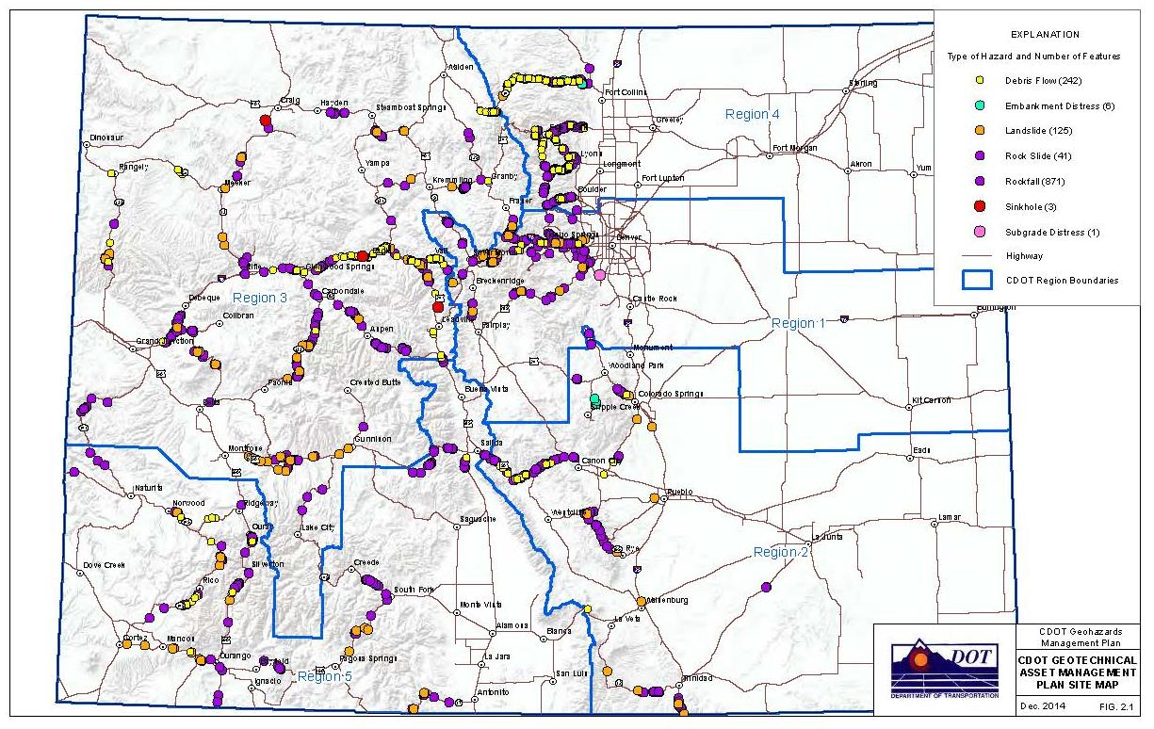
GMP Inventory
Notes:
Mention expert elicitation

Slide 3
Approach Evolution
Adapting risk calculations to CDOT/MAP-21 performance areas
Potential impacts to safety, mobility, maintenance/condition metrics
Fitting the plan into the CDOT TAM models
Risk aggregation versus separation
Finding the one performance measure
Challenges with defining sites
Notes:
Mention expert elicitation

Slide 4
CDOT GMP Risk Cost
Cost Based Risk Calculation
Produces a annual risk cost value for the given asset
R(safety, mobility, or maintenance) = P_{(H)} x P_{(S:H)} x V_{(Prop:S)}
Probability of the hazard
Condition measures converted to probability
Probability of impact
Value ($)

Slide 5
Safety Risk Cost Example
Consequence
No accidents: $0
1-2 accidents: $3,500
3-4 accidents: $10,500
5-10 accidents/injury: $35,000
Injury: $91,600
Likelihood:
Combination of condition scores and AADT
Result = Segment Safety Risk Cost ($)

Slide 6
Mobility Risk Cost
Consequence
Negligible: $0
Minor delay <1hr: 0.5hr x $21/hr x AADT
Major delay 1-24 hours: 12hr x $21/hr x AADT
Critical delay 1-5 days: 2 days x 24 hrs x $21/hr x AADT
Catastrophic >5 days: 5 days x 24 hrs x $21/hr x AADT
Apply a detour factor for Major to Catastrophic delays
Likelihood:
Based on condition scores
Result = Segment Mobility Risk Cost ($)
Notes:
Note: can consider more variables for greater delay but will increase calculation complexity and may not significantly change outcome

Slide 7
Maintenance Risk Cost
Consequence to Maintenance
Incidental <$25K: use $5K
Minimal $25K-$100K: use $50K
Major $100K-$500K: use $200K
Catastrophic >$500K: use $1M
Costs based on Enterprise Accounting data or other department reports
Likelihood:
Based on a condition scores
Result = Segment Maintenance Risk Cost ($)

Slide 8
Aggregation or Separation of Risks
Perform mitigation planning/trade off analysis for each performance area or as a sum of all risks
Manage only safety, condition, or mobility
Manage all together
Equal weighting between performance areas

Slide 9
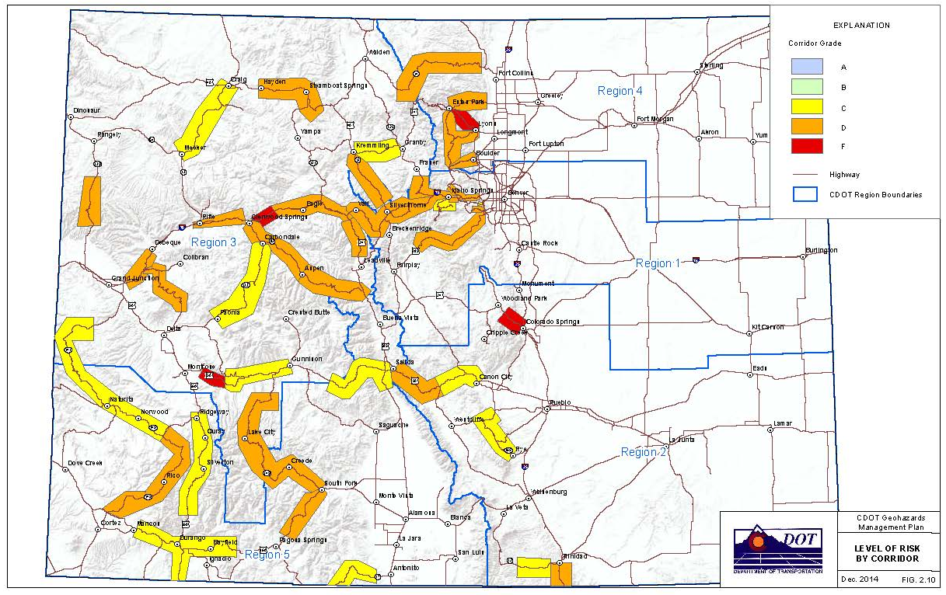
Level of Risk Grading
Level of Risk (LOR) – Geotechnical Performance Measure
A, B, C, D, F Grading based on safety, mobility, and maintenance risk scores
Notes:
Mention expert elicitation

Slide 10
CDOT GMP Level of Risk Metric
A = <$1000
B = $1,000 - $5,000
C = $5,000 - $50,000
D = $50,000 - $100,000
E = >$100,000

Slide 11
Site versus GMP Segment
Site
Site – difficulty with accuracy in reporting and measurement (when does one site become another site, e.g. different hazard types or different sites of the same type)
Challenge when aggregating hazards
Segment
GMP Segment of 0.1 mile
Allows for overlapping hazards in same segment (rockfall, rockslide, landslide, avalanche, etc.)
All events in a segment are summed to determine risk costs for safety, mobility, and maintenance

Slide 12
Implementing the GMP
Setting Targets
Determining Performance (in a risk based system)
The affect mitigation has on performance
Passive
Active
Life cycle (deterioration curve)
Cross Asset Optimization
Want vs Need

Slide 13
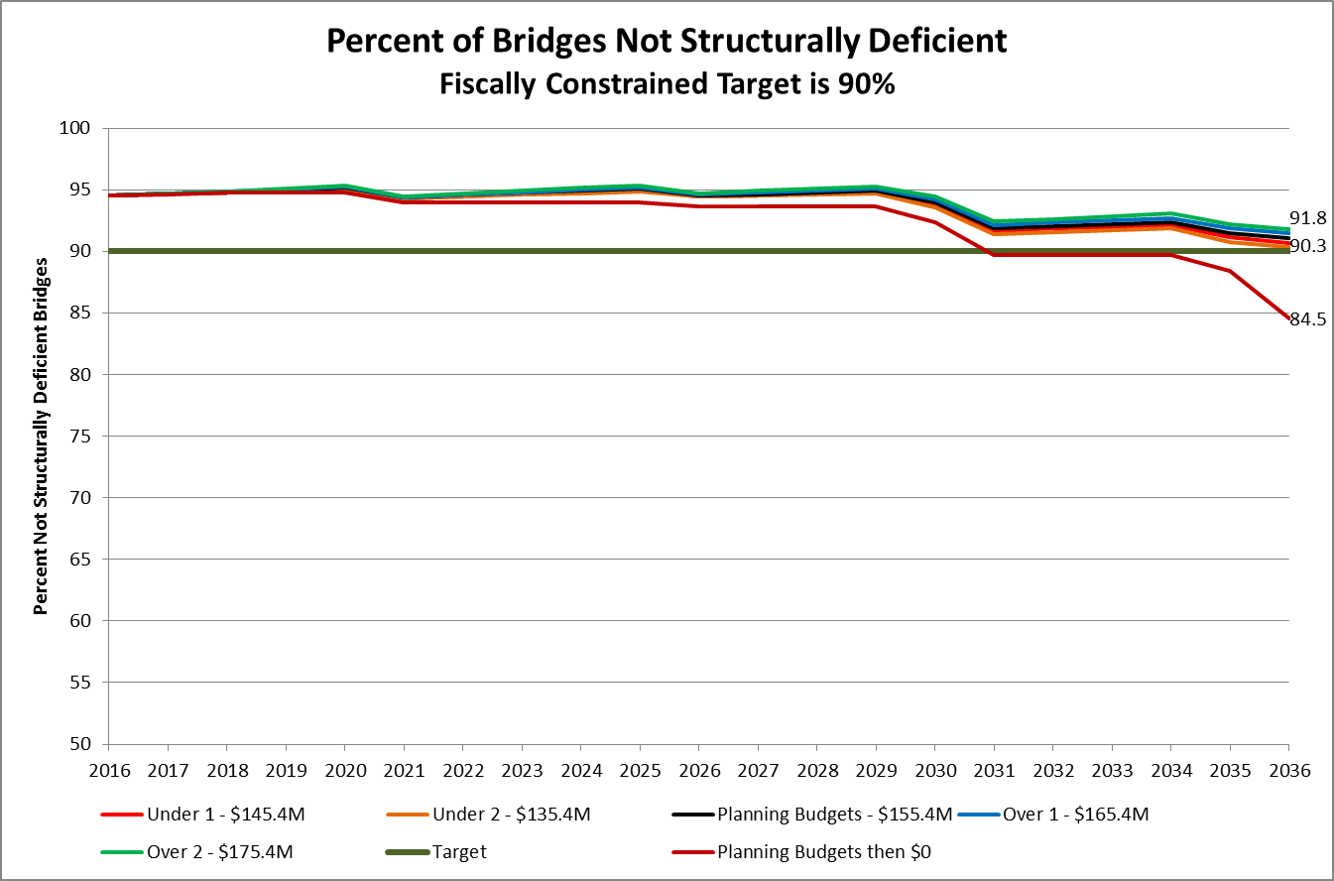
Performance Curve - Bridge
This looks reasonable. How hard can it be?
Notes:
The budgets shown do not include these fixed costs: $50M to the viaduct, $15M for debt service and $10M for inspections. The $165M request for FY17 compares to $89M on this graph (50 + 39).

Slide 14
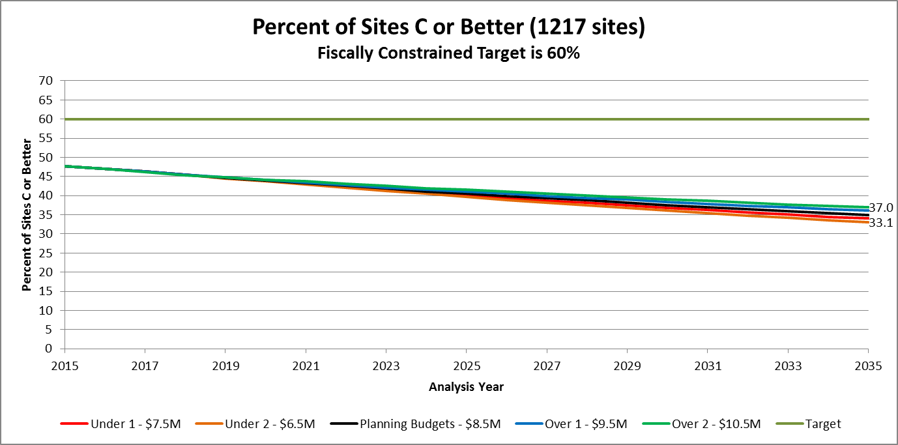
Performance Curve - Geohazards
Well … this doesn’t look good, lets change it!

Slide 15
Performance Curve - Geohazards
Hmm …. Maybe now is a good time to ask for more money?

Slide 16
Want vs. Need

Slide 17
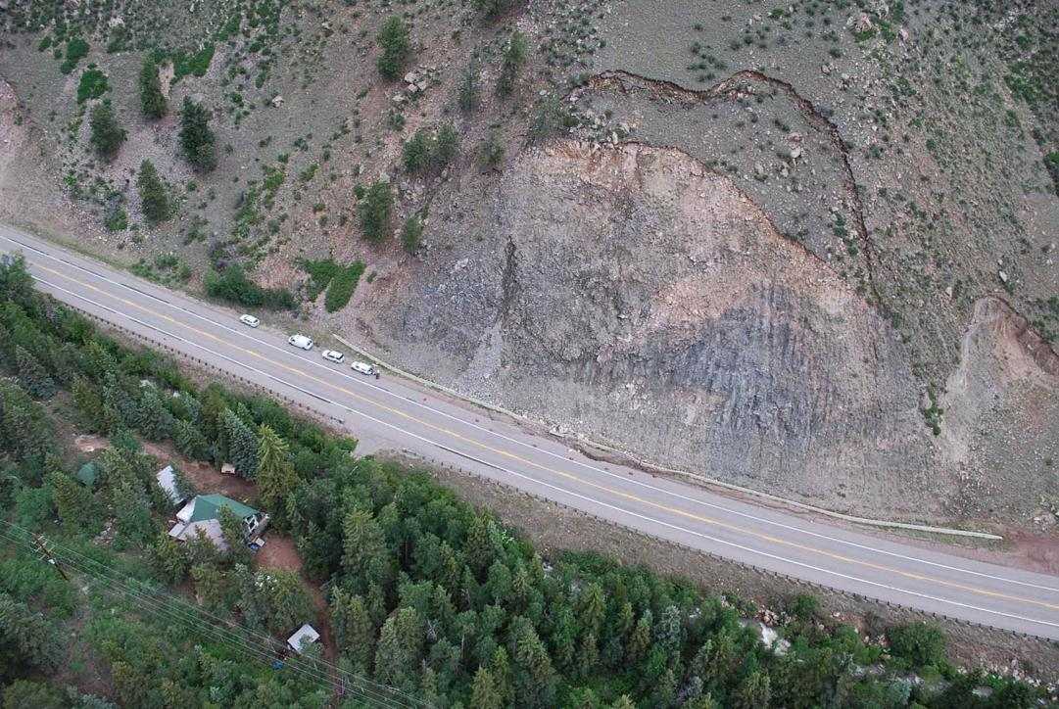
Should we try to fix this?

Slide 18
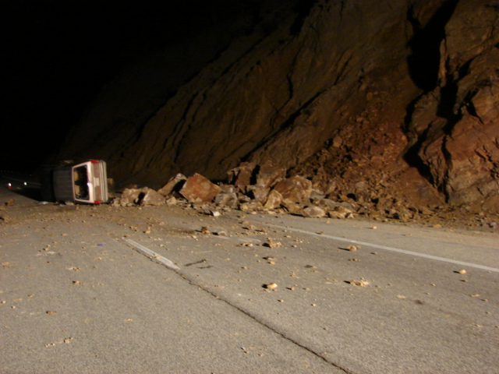
Should we try to stop this?

Slide 19
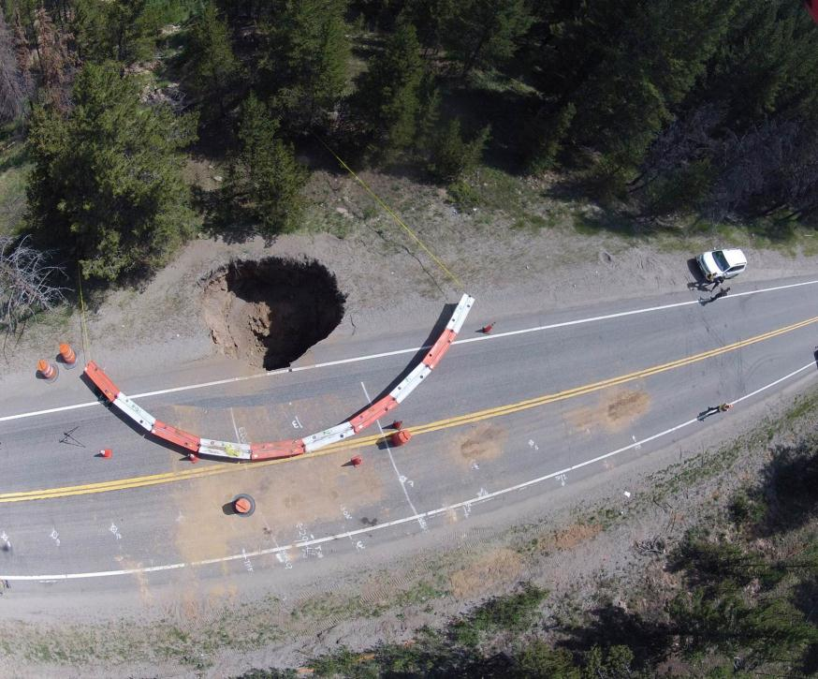
Should we try to find these?

Slide 20
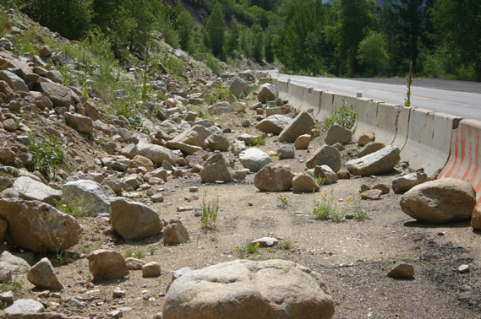
Or should we try to keep this clean?
Notes:
20
Rockfall catchments (ditch). Probably the most common method of protection.
A combination of ditch and a construction a stable cut is the best approach.

Slide 21
Observations … Questions
How effective is our mitigation?
What is the life cycle of our device?
What is the life cycle for our “asset”. How long does it take a rock cut to deteriorate? It depends isn’t a valid answer for building a curve.
What is a realistic target?

Slide 22
Drive Safely

